Slide 1
DDBMS
Introduction to DDBMS
Architecture of DDBs
Storing data in DDBs
Distributed catalog management
Distributed query processing
Transaction Processing
Distributed concurrency control and recovery

Slide 2
I.Introduction to DDBMS
Data in a distributed database system is stored across several sites.
Each site is typically managed by a DBMS that can run independently of the other sites that co-operate in a transparent manner.
  Transparent implies that each user within the system may access all of the data within all of the databases as if they were a single database
There should be ‘location independence’ i.e.- as the user is unaware of where the data is located.
It is possible to move the data from one physical location to another without affecting the user.

Slide 3
DDBMS properties
Distributed data independence: Users should be able to ask queries without specifying where the referenced relations, or copies or fragments of the relations, are located.
Distributed transaction atomicity: Users should be able to write transactions that access and update data at several sites just as they would write transactions over purely local data.

Slide 4

DISTRIBUTED PROCESSING ARCHITECTURE
CLIENT
CLIENT
CLIENT
CLIENT
LAN
LAN
CLIENT
CLIENT
CLIENT
CLIENT
WIDE AREA NETWORK
Delhi
Mumbai
CLIENT
CLIENT
CLIENT
CLIENT
LAN
LAN
DBMS
CLIENT
CLIENT
CLIENT
CLIENT
Hyderabad
Pune

Slide 5
DISTRIBUTED DATABASE ARCHITECTURE
CLIENT
CLIENT
CLIENT
CLIENT
CLIENT
LAN
DBMS
DBMS
CLIENT
CLIENT
CLIENT
CLIENT
WIDE AREA NETWORK
Delhi
Mumbai
CLIENT
CLIENT
CLIENT
CLIENT
CLIENT
LAN
DBMS
DBMS
CLIENT
CLIENT
CLIENT
CLIENT
Hyderabad
Pune

Slide 6


Distributed database
Communication Network- DBMS and Data at each node
Users are unaware of the distribution of the data
Location transparency

Slide 7
Types of Distributed Databases
Homogeneous distributed database system :
  If data is distributed but all servers run the same DBMS software.
Heterogeneous distributed database system:
  If different sites run under the control of different DBMSs, if it is essential autonomously they are connected to enable access to data from multiple sites.
The key to build heterogeneous systems is to have well-accepted standards for gateway protocols.
A gateway protocol is an API that exposes DBMS functionality to external applications.

Slide 8
DDBMS
Introduction to DDBMS
Architecture of DDBs
Storing data in DDBs
Distributed catalog management
Distributed query processing
Transaction Processing
Distributed concurrency control and recovery

Slide 9
2.DISTRIBUTED DBMS ARCHITECTURES
Client-Server Systems:
Collaborating Server Systems
Middleware Systems

Slide 10
1.Client-Server Systems:
A Client-Server system has one or more client processes and one or more server processes,
A client process can send a query to any one server process.
Clients are responsible for user-interface issues,
Servers manage data and execute transactions.
A client process could run on a personal computer and send queries to a server running on a mainframe.
The Client-Server architecture does not allow a single query to span multiple servers

Slide 11


TERMINALS
MAINFRAME COMPUTER
DUMB
DUMB
SPECIALISED NETWORK CONNECTION
DUMB
PRESENTATION LOGIC
BUSINESS LOGIC
DATA LOGIC

Slide 12
2.Collaborating Server Systems
The client process would have to be capable of breaking such a query into appropriate subqueries.
A Collaborating Server system can have a collection of database servers, each capable of running transactions against local data, which cooperatively execute transactions spanning multiple servers.
When a server receives a query that requires access to data at other servers, it generates appropriate subqueries to be executed by other servers .
Puts the final results together of all the sub-queris to compute answers to the original query.

Slide 13

M:N CLIENT/SERVER DBMS ARCHITECTURE
SERVER #1
CLIENT#1
D/BASE
CLIENT#2
SERVER #2
D/BASE
CLIENT#3
NOT TRANSPARENT!

Slide 14
3.Middleware Systems:
The Middleware architecture is designed to allow a single query to span multiple servers, without requiring all database servers to be capable of managing such multisite execution strategies.
It is especially attractive when trying to integrate several legacy systems, whose basic capabilities cannot be extended.

Slide 15
DDBMS
Introduction to DDBMS
Architecture of DDBs
Storing data in DDBs
Distributed catalog management
Distributed query processing
Transaction Processing
Distributed concurrency control and recovery

Slide 16
3.Storing Data in DDBs
In a distributed DBMS, relations are stored across several sites.
Accessing a relation that is stored at a remote site includes message-passing costs.
A single relation may be partitioned or fragmented across several sites.

Slide 17
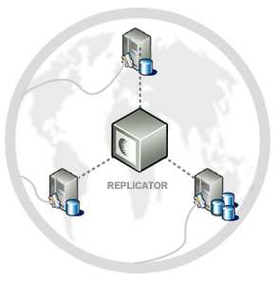
Types of Fragmentation:
Horizontal fragmentation: The union of the horizontal fragments must be equal to the original relation. Fragments are usually also required to be disjoint.
Vertical fragmentation: The collection of vertical fragments should be a lossless-join decomposition.

Slide 18


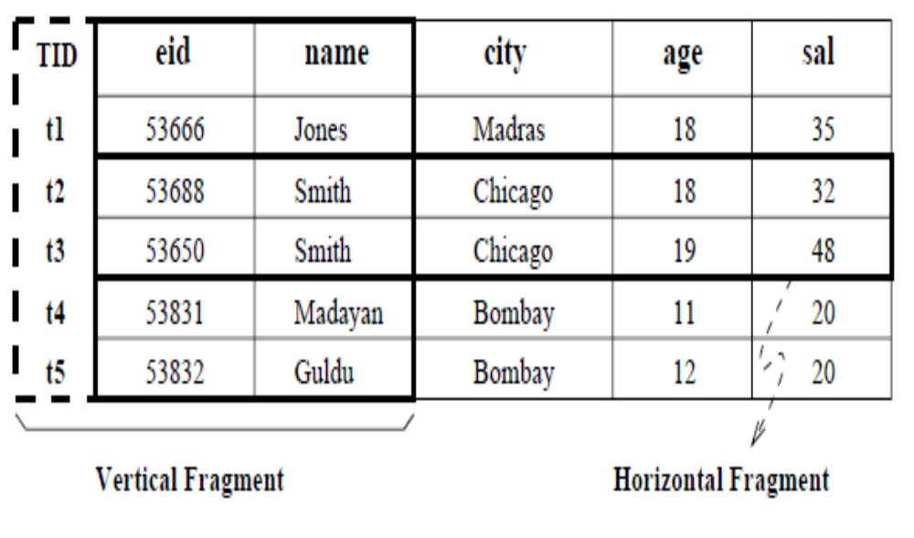


Slide 19
Replication
Replication means that we store several copies of a relation or relation fragment.
The motivation for replication is twofold:
  Increased availability of data:
  Faster query evaluation:
Two kinds of replications
  synchronous replication
  asynchronous replication

Slide 20
DDBMS
Introduction to DDBMS
Architecture of DDBs
Storing data in DDBs
Distributed Catalog Management
Distributed Query Processing
Transaction Processing
Distributed concurrency control and recovery

Slide 21
4.Distributed Catalog Management
Naming Objects
If a relation is fragmented and replicated, we must be able to uniquely identify each replica of each fragment.
  A local name field
  A birth site field
Catalog Structure
A centralized system catalog can be used (It is vulnerable to failure of the site containing the catalog).
An alternative is to maintain a copy of a global system catalog. (compromises site autonomy)

Slide 22
4.Distributed Catalog Management
A better approach:
Each site maintains a local catalog that describes all copies of data stored at that site.
In addition, the catalog at the birth site for a relation is responsible for keeping track of where replicas of the relation are stored.

Slide 23
DDBMS
Introduction to DDBMS
Architecture of DDBs
Storing data in DDBs
Distributed Catalog management
Distributed Query Processing
Transaction Processing
Distributed concurrency control and recovery

Slide 24
5.Distributed Query Processing
Distributed query processing: Transform a high-level query (of relational calculus/SQL) on a distributed database (i.e., a set of global relations) into an equivalent and efficient lower-level query (of relational algebra) on relation fragments.
Distributed query processing is more complex
– Fragmentation/replication of relations
– Additional communication costs
– Parallel execution

Slide 25
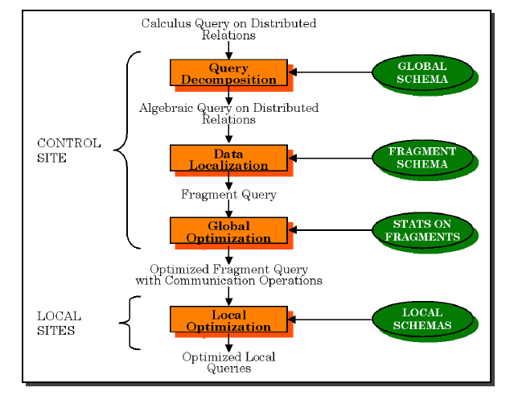
Distributed Query Processing Steps

Slide 26
5.Distributed Query Processing
  Sailors(sid: integer, sname: string, rating: integer, age: real)
  Reserves(sid: integer, bid: integer, day: date, rname: string)
Assume Reserves and Sailors relations
  each tuple of Reserves is 40 bytes long
  a page can hold 100 Reserves tuples
  1,000 pages of such tuples.
  each tuple of Sailors is 50 bytes long
  a page can hold 80 Sailors Tuples
  500 pages of such tuples
How to estimate the cost?

Slide 27
5.Distributed Query Processing
Criteria for measuring the cost of a query evaluation strategy
  For centralized DBMSs number of disk accesses (# blocks read / written)
  For distributed databases, additionally
    The cost of data transmission over the network
    Potential gain in performance from having several sites processing parts of the query in parallel

Slide 28
5.Distributed query processing
To estimate the cost of an evaluation strategy, in addition to counting the number of page I/Os.
we must count the number of pages that are shipped is a communication costs.
Communication costs is a significant component of overall cost in a distributed database.
  Nonjoin Queries in a Distributed DBMS
  Joins in a Distributed DBMS
  Cost-Based Query Optimization

Slide 29
5.Distributed Query Processing
1.Nonjoin Queries in a Distributed DBMS
Even simple operations such as scanning a relation, selection, and projection are affected by fragmentation and replication.
        SELECT S.age
        FROM Sailors S
        WHERE S.rating > 3 AND S.rating < 7
Suppose that the Sailors relation is horizontally fragmented, with all tuples having a rating less than 5 at Mumbai and all tuples having a rating greater than 5 at Delhi.
The DBMS must answer this query by evaluating it at both sites and taking the union of the answers.

Slide 30
5.Distributed Query Processing
  Eg 1: SELECT avg(age)
        FROM Sailors S
        WHERE S.rating > 3 AND S.rating < 7
taking the union of the answers is not enough
  Eg 2: SELECT S.age
        FROM Sailors S
        WHERE S.rating > 6
taking the union of the answers is not enough
Eg 3: Suppose that the Sailors relation is vertically fragmented, with the sid and rating fields at MUMBAI and the sname and age fields at DELHI
This vertical fragmentation would be a lossy decomposition

Slide 31

5.Distributed Query Processing
  Eg 4:the entire Sailors relation is stored at both MUMBAI and DELHI sites.
Where should the query be executed?
2 Joins in a Distributed DBMS
Eg: the Sailors relation is stored at MUMBAI, and the Reserves relation is stored at DELHI.
Joins of relations at different sites can be very expensive.
JOIN STRATEGY
  Fetch as needed
  Ship whole
  Semijoins
  Bloomjoins
Which strategy is better for me?

Slide 32
5.Distributed Query Processing
1.Fetch As Needed
Page-oriented Nested Loops join: For each page of R, get each page of S, and write out matching pairs of tuples <r, s>, where r is in R-page and s is in S-page.
We could do a page-oriented nested loops join in MUMBAI with Sailors as the outer, and for each Sailors page, fetch all Reserves pages from DELHI.
If we cache the fetched Reserves pages in MUMBAI until the join is complete, pages are fetched only once

Slide 33
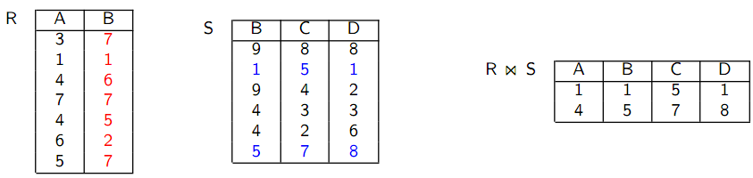

Fetch As Needed: Transferring the relation piecewise
QUERY: The query asks for R S

Slide 34
5.Distributed Query Processing
Assume Reserves and Sailors relations
    each tuple of Reserves is 40 bytes long
    a page can hold 100 Reserves tuples
    1,000 pages of such tuples.
    each tuple of Sailors is 50 bytes long
    a page can hold 80 Sailors Tuples
    500 pages of such tuples
td is cost to read/write page; ts is cost to ship page.
The cost is = 500td to scan Sailors
for each Sailors page, the cost of scanning shipping all of Reserves, which is =1000(td + ts).
The total cost is = 500td + 500, 000(td + ts).

Slide 35
5.Distributed Query Processing
This cost depends on the size of the result.
The cost of shipping the result is greater than the cost of shipping both Sailors and Reserves to the query site.
2.Ship to One Site (sort-merge-join)
The cost of scanning and shipping Sailors, saving it at DELHI, and then doing the join at DELHI is
  =500(2td + ts) + (Result)td,
The cost of shipping Reserves and doing the join at MUMBAI is
  =1000(2td+ts)+(Result)td.

Slide 36
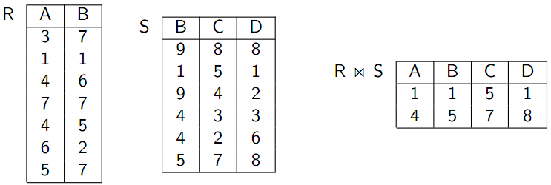
Ship Whole: Transferring the complete relation
QUERY: The query asks for R S

Slide 37
5.Distributed Query Processing
Ship Whole vs Fetch as needed:
Fetch as needed results in a high number of messages
Ship whole results in high amounts of transferred data
Note: Some tuples in Reserves do not join with any tuple in Sailors, we could avoid shipping them.
3.Semijoins and Bloomjoins
Semijoins: 3 steps:
At MUMBAI, compute the projection of Sailors onto the join columns i.e sid and ship this projection to DELHI.
2. At DELHI, compute the natural join of the projection received from the first site with the Reserves relation.
The result of this join is called the reduction of Reserves with respect to Sailors. ship the reduction of Reserves to MUMBAI.
3. At MUMBAI, compute the join of the reduction of Reserves with Sailors.

Slide 38
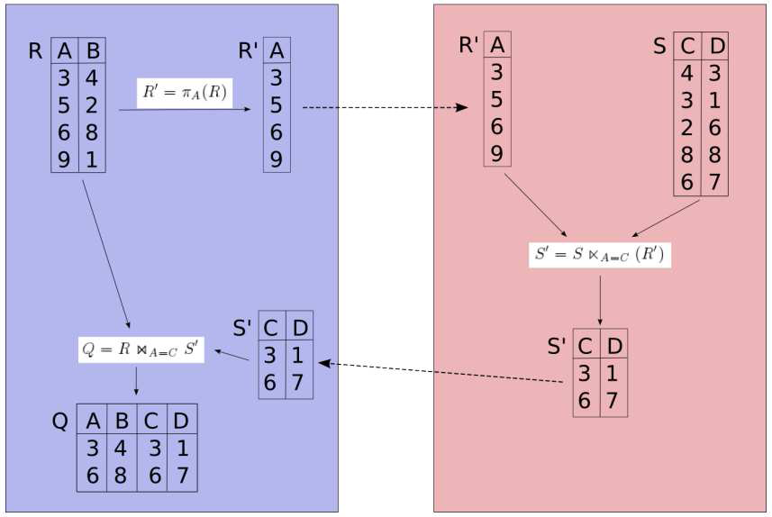
Semijoin:
Semijoin: Requesting all join partners in just one step.

Slide 39
5.Distributed query processing
Bloomjoins: 3 steps:
At MUMBAI, A bit-vector of (some chosen) size k is computed by hashing each tuple of Sailors into the range 0 to k −1 and setting bit i to 1. if some tuple hashes to i, and 0 otherwise then ship this to DELHI
At DELHI, the reduction of Reserves is computed by hashing each tuple of Reserves (using the sid field) into the range 0 to k − 1, using the same hash function used to construct the bit-vector, and discarding tuples whose hash value i corresponds to a 0 bit.ship the reduction of Reserves to MUMBAI.
At MUMBAI, compute the join of the reduction of Reserves with Sailors.

Slide 40
Bloom join:
Bloom join:
Also known as bit-vector join
Avoiding to transfer all join attribute values to the other node
Instead transferring a bitvector B[1 : : : n]
Transformation
  Choose an appropriate hash function h
  Apply h to transform attribute values to the range [1 : : : n]
  Set the corresponding bits in the bitvector B[1 : : : n] to

Slide 41
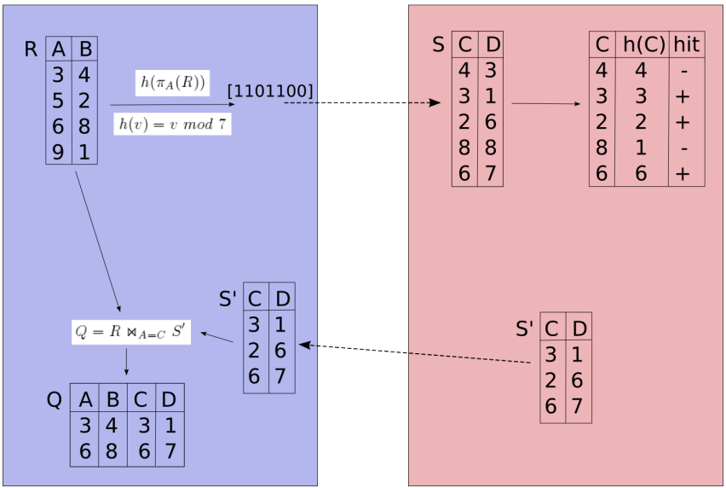
Bloom join:

Slide 42
Cost-Based Query Optimization
optimizing queries in a distributed database poses the following additional challenges:
  Communication costs must be considered. If we have several copies of a relation, we must also decide which copy to use.
  If individual sites are run under the control of different DBMSs, the autonomy of each site must be respected while doing global query planning.

Slide 43
Cost-Based Query Optimization
Cost-based approach; consider all plans, pick cheapest; similar to centralized optimization.
    Difference 1: Communication costs must be considered.
    Difference 2: Local site autonomy must be respected.
    Difference 3: New distributed join methods.
Query site constructs global plan, with suggested local plans describe processing at each site.
If a site can improve suggested local plan, free to do so.

Slide 44
6.DISTRIBUTED TRANSACTIONS PROCESSING
A given transaction is submitted at some one site, but it can access data at other sites.
When a transaction is submitted at some site, the transaction manager at that site breaks it up into a collection of subtransactions that execute at different sites.

Slide 45
7.Distributed Concurrency Control
Lock management can be distributed across sites in many ways:
Centralized: A single site is incharge of handling lock and unlock requests for all objects.
Primary copy: One copy of each object is designated as the primary copy.
  All requests to lock or unlock a copy of this object are handled by the lock manager at the site where the primary copy is stored.
Fully distributed: Requests to lock or unlock a copy of an object stored at a site are handled by the lock manager at the site where the copy is stored.

Slide 46
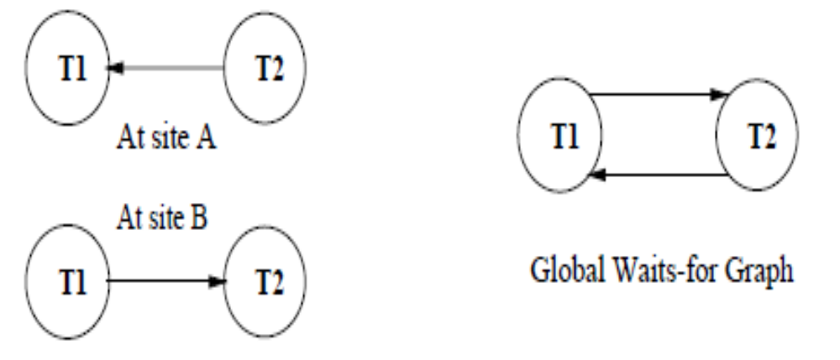
7.Distributed Concurrency Control

Slide 47
Phantom Deadlocks: delays in propagating local information might cause the deadlock detection algorithm to identify `deadlocks' that do not really exist. Such situations are called phantom deadlocks

Slide 48
7.Distributed Recovery
Recovery in a distributed DBMS is more complicated than in a centralized DBMS for the following reasons:
New kinds of failure can arise:
  failure of communication links.
  failure of a remote site at which a subtransaction is executing.
Either all subtransactions of a given transaction must commit, or none must commit.
This property must be guaranteed in spite of any combination of site and link failures.

Slide 49
7.Distributed Recovery
Two-Phase Commit (2PC):
Site at which Xact originates is coordinator;
other sites at which it executes subXact are subordinates.
When the user decides to commit a transaction:
  The commit command is sent to the coordinator for the transaction.
  This initiates the 2PC protocol:

Slide 50
7.Distributed Recovery(2pc)
Coordinator sends prepare msg to each subordinate.
Subordinate force-writes an abort or prepare log record and then sends a no or yes msg to coordinator.
If coordinator gets all yes votes, force-writes a commit log record and sends commit msg to all subs. Else, force-writes abort log rec, and sends abort msg.
Subordinates force-write abort/commit log rec based on msg they get, then send ack msg to coordinator.
Coordinator writes end log rec after getting ack msg from all subs

Slide 51
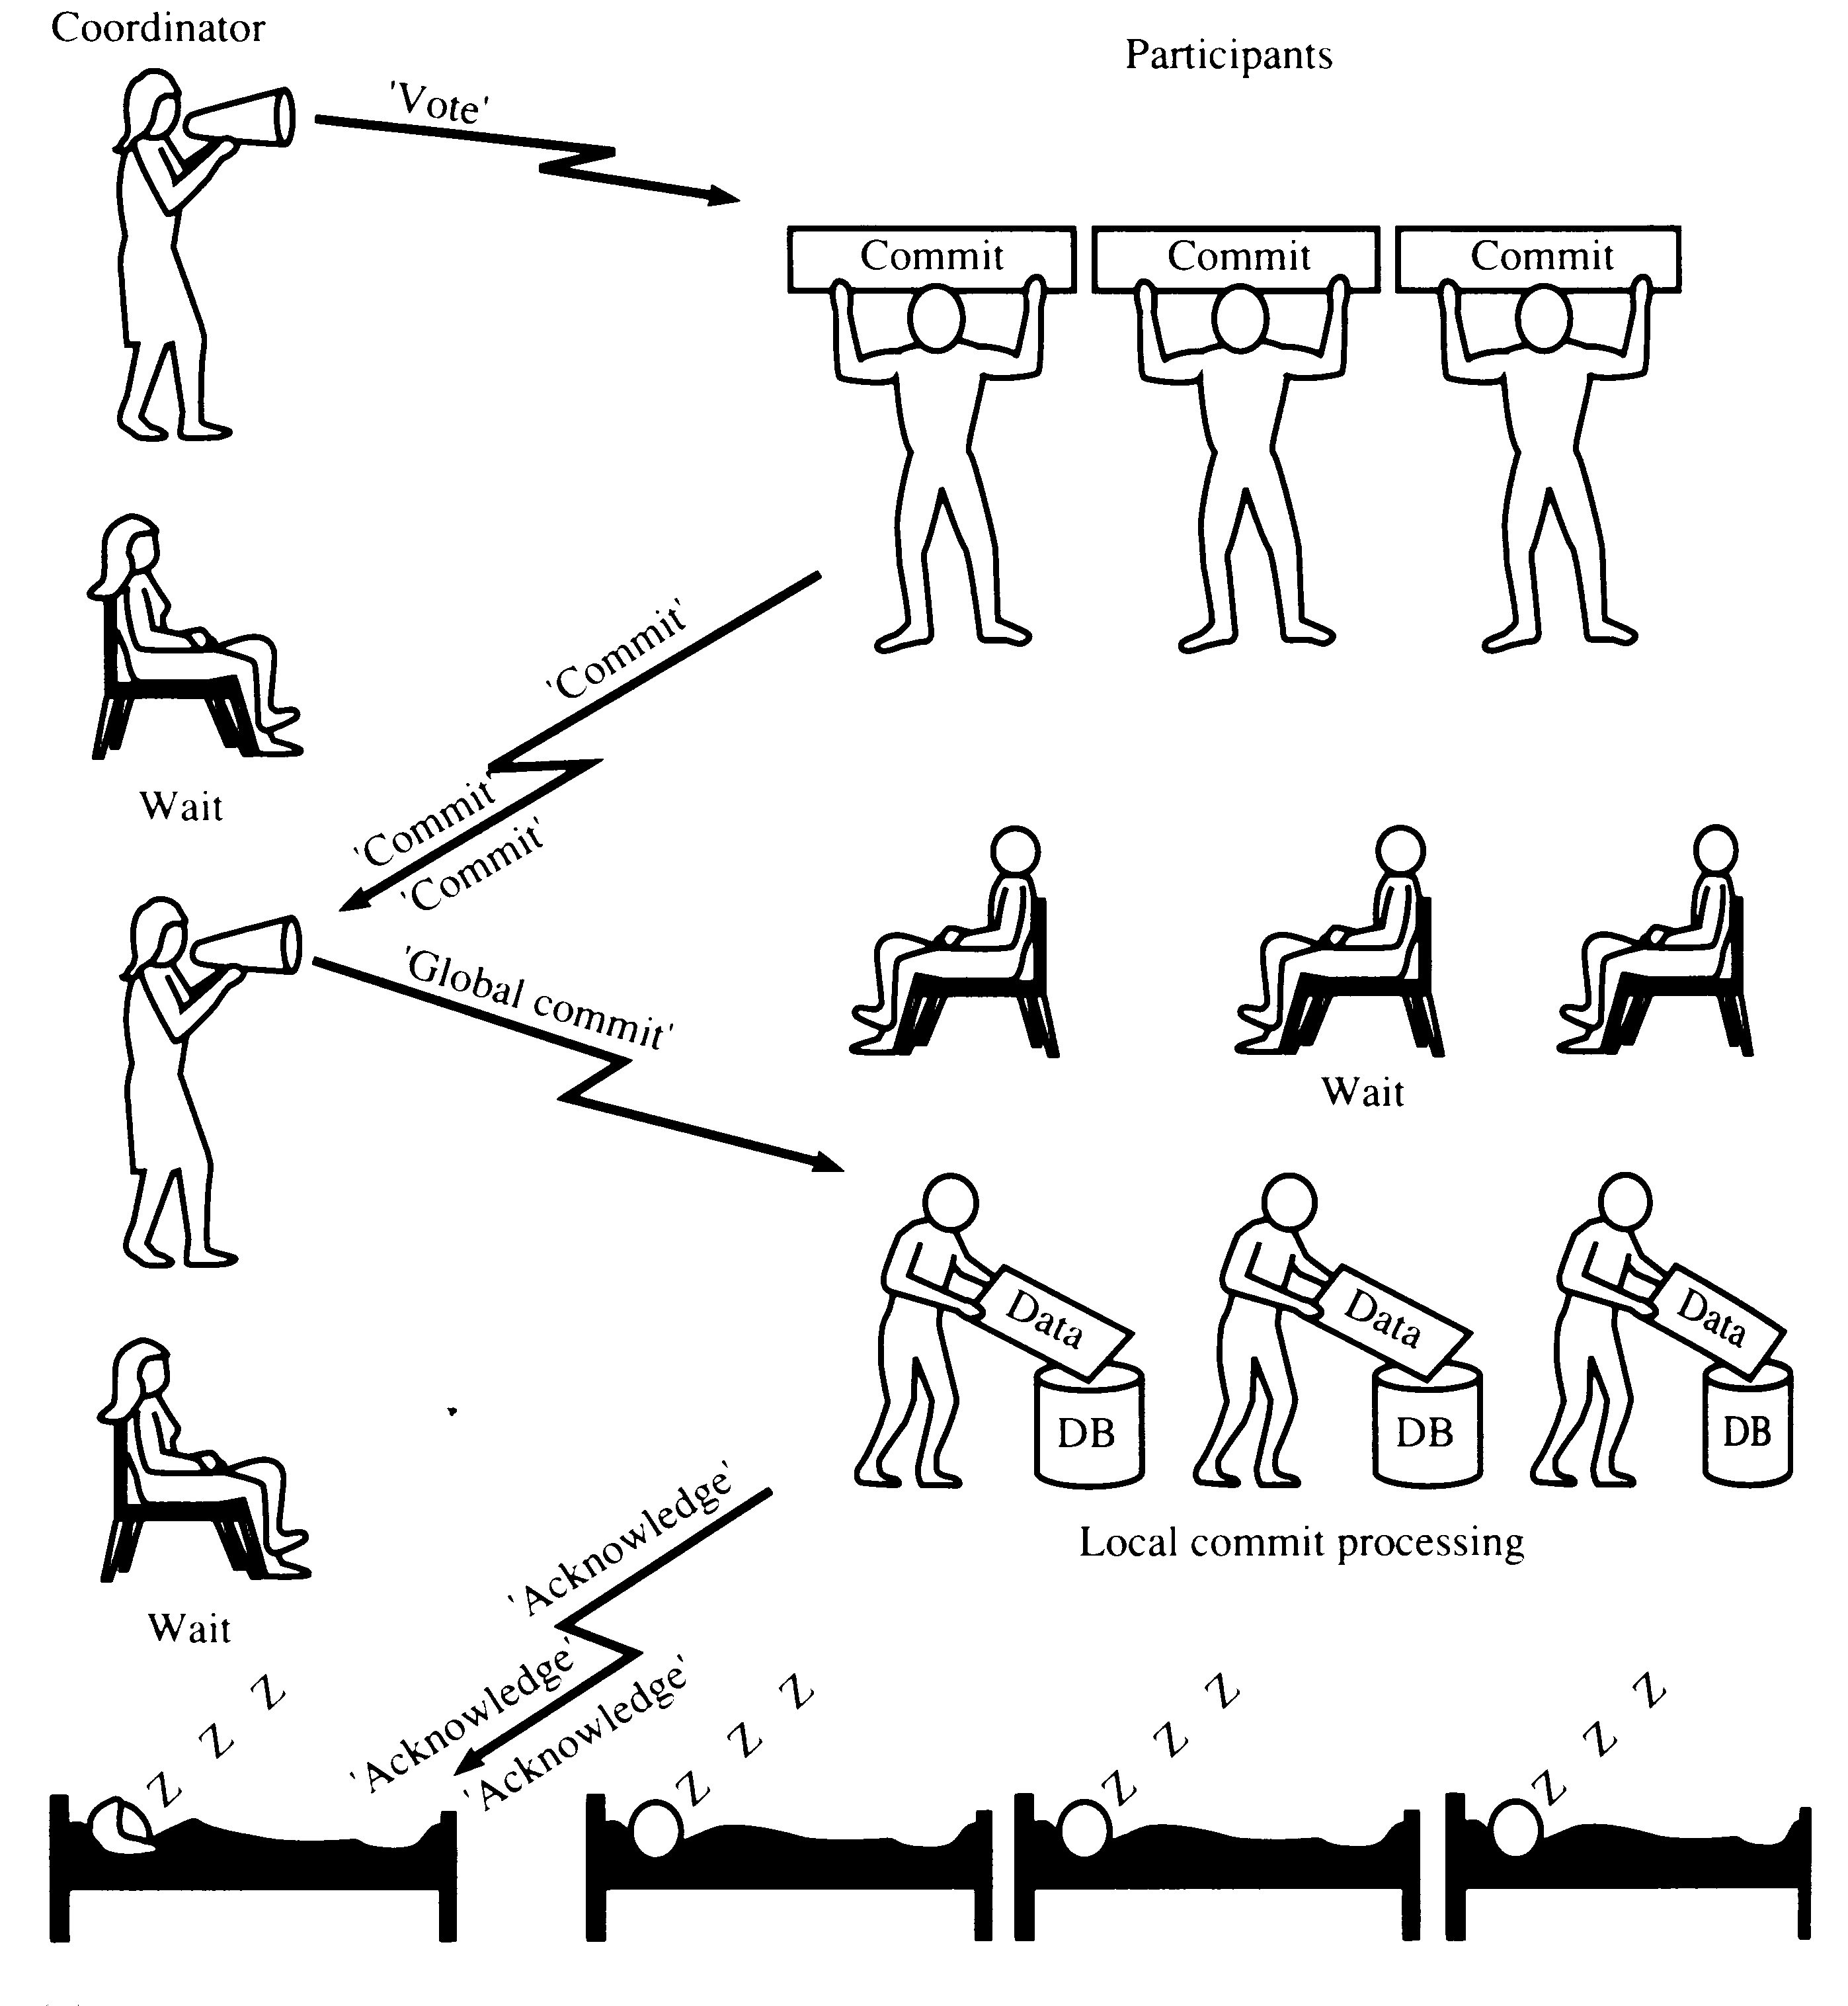
TWO-PHASE COMMIT (2PC) - commit

Slide 52
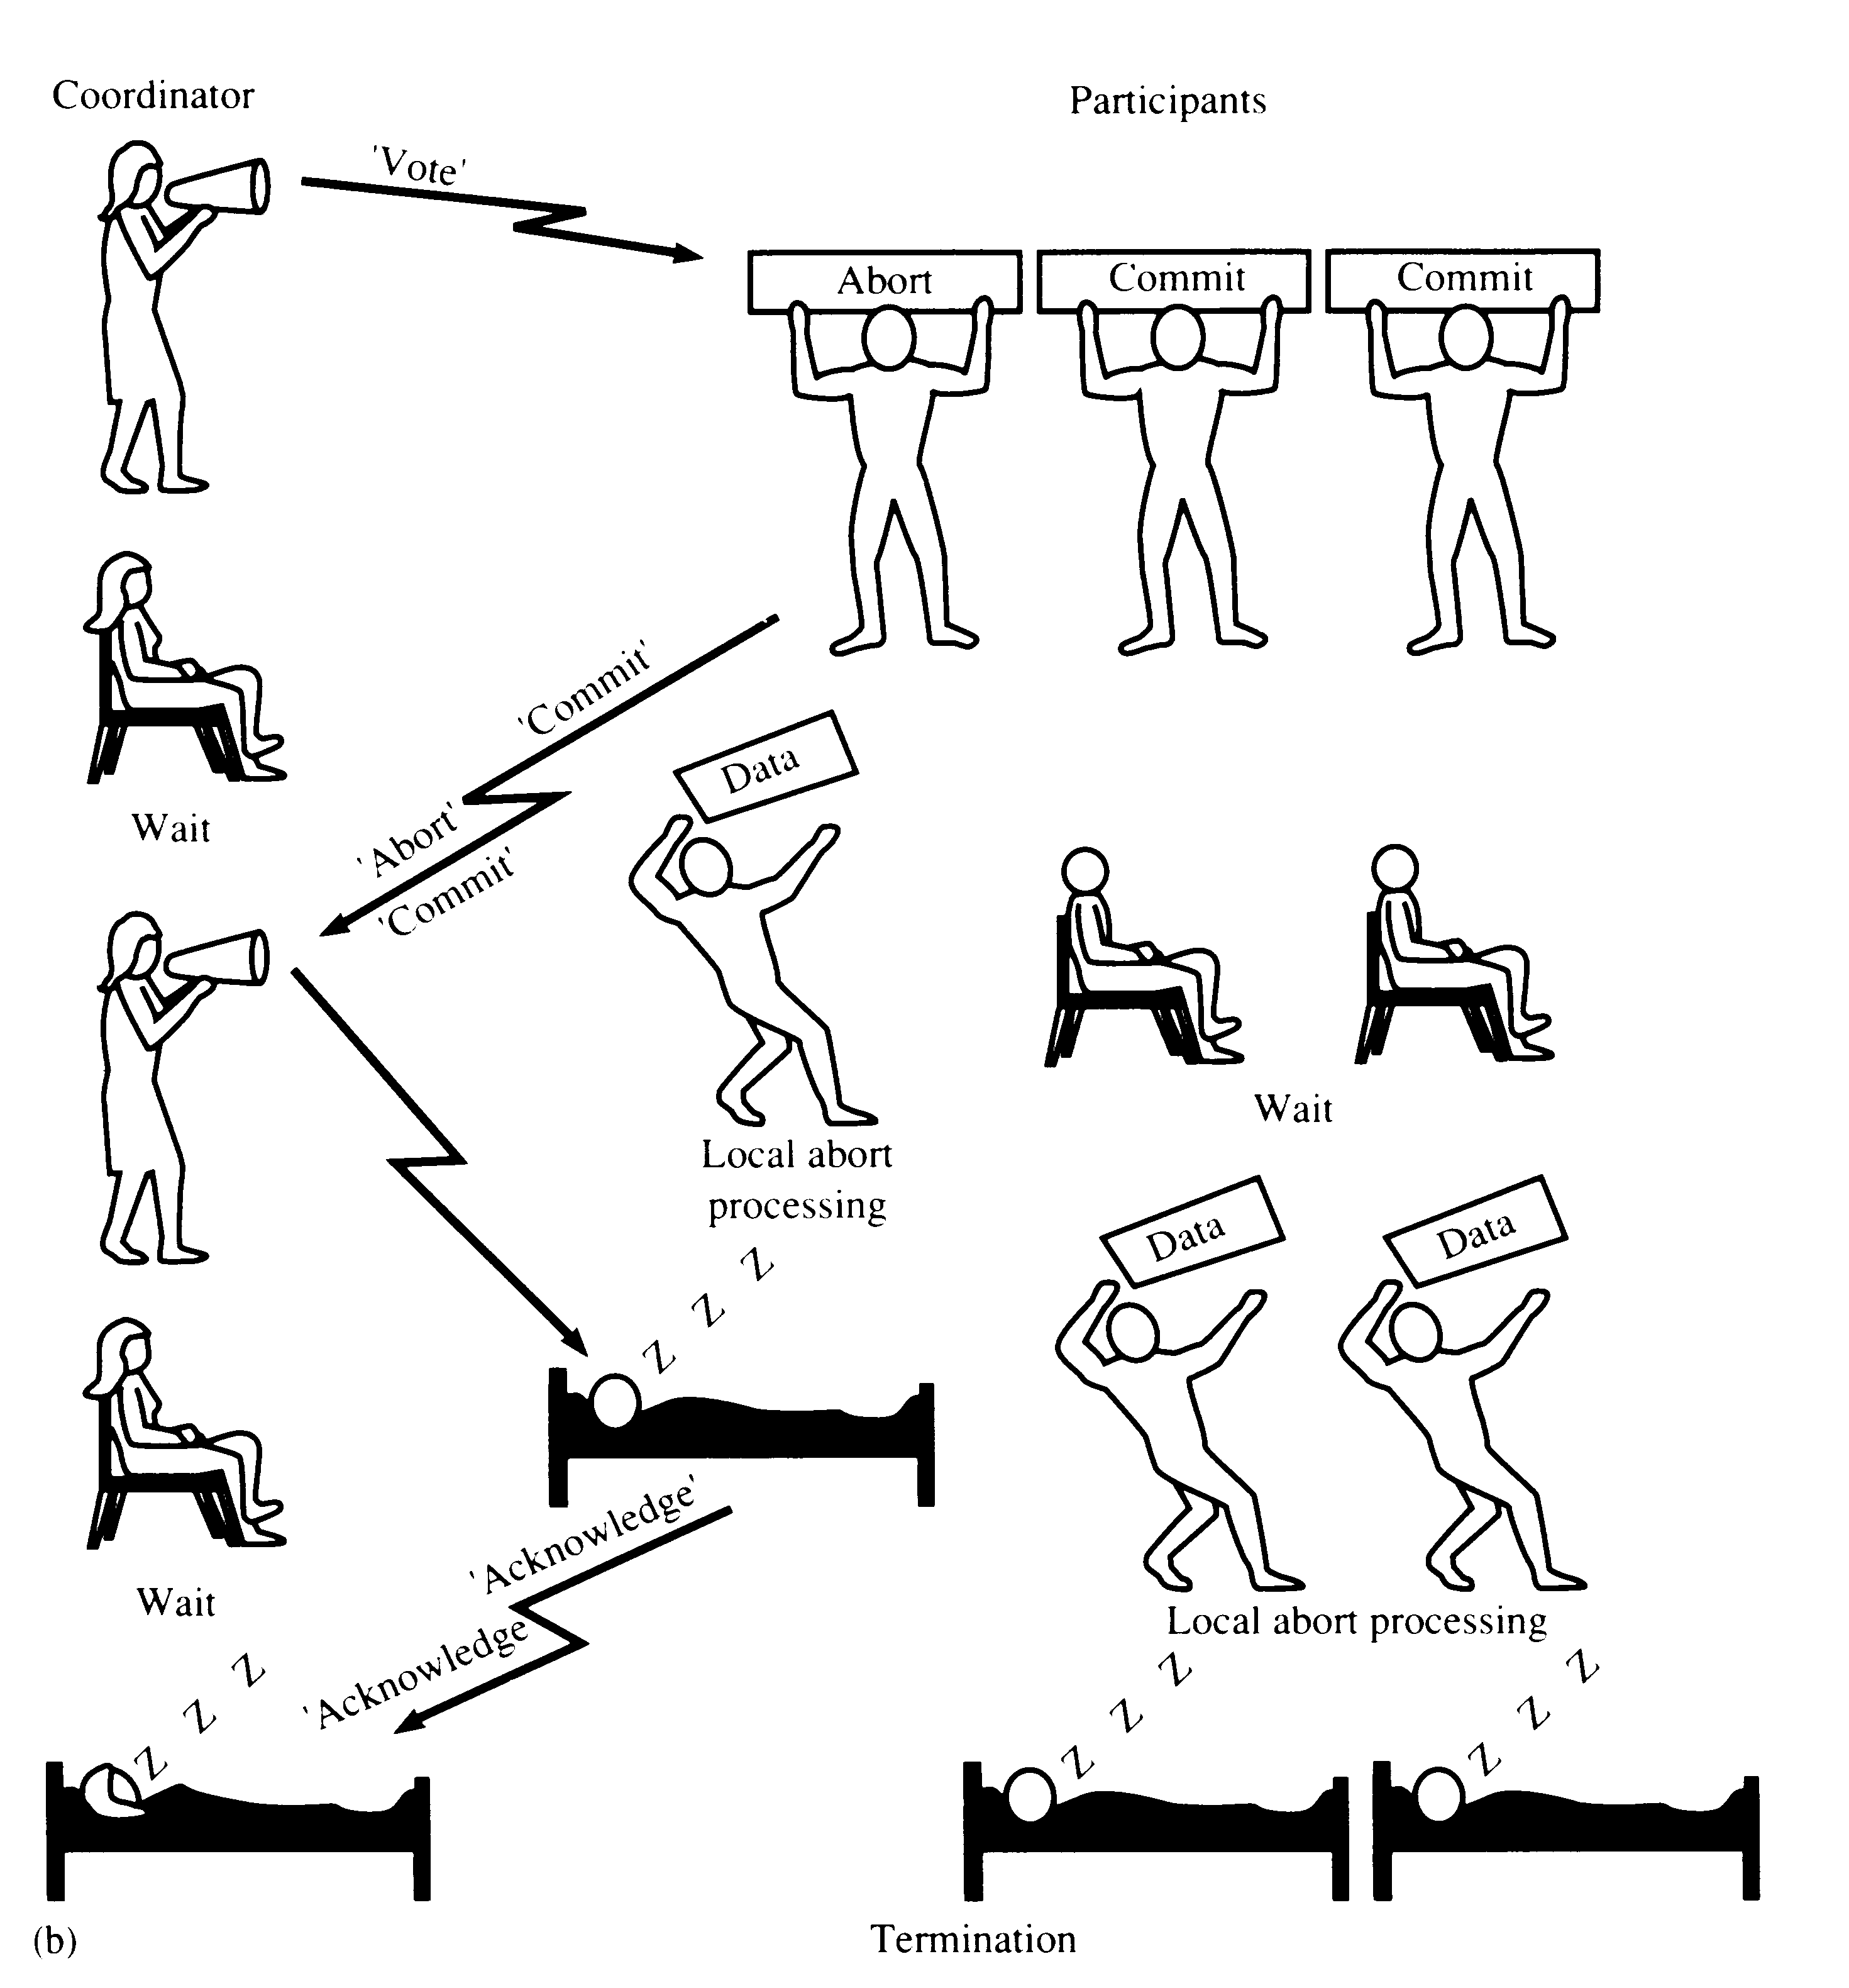
TWO-PHASE COMMIT (2PC) - ABORT
‘Global Abort’

Slide 53
7.Distributed Recovery(3pc)
Three-Phase Commit
A commit protocol called Three-Phase Commit (3PC) can avoid blocking even if the coordinator site fails during recovery.
The basic idea is that when the coordinator sends out prepare messages and receives yes votes from all subordinates.
It sends all sites a precommit message, rather than a commit message.
When a sufficient number of acks have been received more than the maximum number of failures that must be handled.
The coordinator force-writes a commit log record and sends a commit message to all subordinates.

Slide 54
Distributed Database
Advantages:
  Reliability
  Performance
  Growth (incremental)
  Local control
  Transparency
Disadvantages:
  Complexity of Query opt.
  Concurrency control
  Recovery
  Catalog management

